Slide 1

Using NIST Tools to Advance Interoperability for Immunization Messaging Implementations
AIRA Conference April 2016, Seattle, Washington
Robert Snelick
National Institute of Standards and Technology (NIST)
April 5th, 2016
Contact: robert.snelick@nist.gov

Slide 2
Agenda
Overview (5m)
NIST Resource Portal (5m)
Immunization Test Suites – Web Applications (35m)
SOAP Testing
HL7 v2.5.1 Release 1.5 Testing
Context-free Testing
Context-based Testing
Data Quality Testing
ONC 2015 Edition HIT Certification (10m)
HL7 v2.5.1 Release 1.4 Testing (2m)
Web Service Validation (10m)
NIST Implementation Guide Authoring Tool (IGAMT) (10m)
Future Work (5m)
Questions
Notes:
Limited: by the (availability/testability/in-scope for this) of functional requirements; time/resources

Slide 3




Collaboration is Key
HHS/ONC

Slide 4
NIST Immunization Suites-Web Applications
Immunization Test Suite: Released 2016
Web based application that supports End-to-End Conformance Testing
Testing of SOAP Envelope and SOAP Connectivity based on the CDC WSDL
Testing of HL7 v2.5.1 Immunization Implementation Guide (R1.5)
Support for all 8 profiles (including Query and Response)
Targeted Test Cases-ONC 2015 Edition Certification
Data Quality Assurance (DQA)
EHR-S and IIS Functional Requirements
Immunization Test Suite: Released 2012
Testing of HL7 v2.5.1 Immunization Implementation Guide (R1.4)
Support the VXU profile
Targeted Test Cases-ONC 2014 Edition Certification
Notes:
Limited: by the (availability/testability/in-scope for this) of functional requirements; time/resources

Slide 5
ONC 2015 Edition HIT Certification
Review ONC 2015 Edition criterion for Immunization Messaging
Understand the impact on the IIS community
Learn how the NIST Immunization Test Suite is used to certify EHR systems
Review NIST Test Cases used in certification
Notes:
Limited: by the (availability/testability/in-scope for this) of functional requirements; time/resources

Slide 6
NIST HL7 v2.x Validation Web Service
Web Service Application Programming Interface (API)
Immunization Messaging Release 1.4 (VXU Only)
Immunization Messaging Release 1.5 (All Profiles)
Example Clients in Java and C#
Validate production messages at IIS sites
Use of validation reports to analyze data quality
Notes:
Limited: by the (availability/testability/in-scope for this) of functional requirements; time/resources

Slide 7
NIST Implementation Guide Authoring Tool (IGAMT)
Tool to create HL7 v2.x implementation guides
Profiling Tool
Create local implementation guides based on National Standard
Produces artifacts for:
Input to Validation Tools (NIST or others)
Message Generation
Profile Viewing
Code Generation
Update on Tool Progress
Pilot Initiatives for Immunization
Immunization Message Implementation Guide R1.6
Local State of Connecticut Implementation Guide
Notes:
Limited: by the (availability/testability/in-scope for this) of functional requirements; time/resources

Slide 8
NIST Resource Portal

Slide 9
NIST Resource Portal
Access point for all NIST HL7 v2.x Resources
Testing Tools
Validations Test Tools
Productivity Tools
IGAMT—Support for Implementation Guides
TCAMT—Support for Test Case Development (in progress)
Testing Artifacts
Profiles
Profile Schemas
Value Set Schemas
Informational Resources
Papers
Presentations
Source Code
Web Based Application
Notes:
Limited: by the (availability/testability/in-scope for this) of functional requirements; time/resources

Slide 10
NIST Immunization Test Suite (2016)
Overview

Slide 11
Immunization Test Suite: Overview and Capabilities
1
Transport
SOAP Envelope Testing
Validate message to SOAP schema and to CDC WSDL
[EHR-S and IIS]
2
SOAP Connectivity Testing
Echo back; Fault generation (Authentication; Message Size, etc.)
[EHR-S and IIS]
3
Content
HL7
Context-free Testing
Cut-n-paste; validate message structure and most vocabulary
[EHR-S and IIS]
4
Cut-n-paste; validate message against test cases and test data
[EHR-S and IIS]
HL7
Context-based Testing
ONC 2015 Certification
5a
Functional
Phase-by-phase testing
Start simple and progress
Independent—can enter at any stage
Phase 4 (ONC 2015 Certification Test Plan)
Multiple levels within a phase
Detailed test cases and associated data
EHR-S Functional Testing
5
Interactive round-trip; scenario and functional testing
[End-to-end Testing]
5b
IIS Functional Testing

Slide 12
Immunization Validation Tool Overview
Tool Key Capabilities
SOAP Envelope Testing | The SOAP Envelop Testing ensures SOAP envelopes are correctly formed, validating the conformance of the messages to the requirements in the SOAP and Transport specifications.
SOAP Connectivity Testing | The SOAP Connectivity Testing evaluates valid SOAP connectivity, the ability to send and receive SOAP messages, validating the conformance of the messages to the requirements in the SOAP and Transport specifications.
Context-Free Testing | Provides a simple and convenient method for testing immunization messages structure and most vocabulary. Validation is perform on messages with or without a SOAP wrapper.
Context-Based Testing | Context-based testing provides, in addition to HL7 Context-free validation, message validation associated with a given test script that includes data for a specific test scenario where the context is known by the validation tool. It also validate messages with a SOAP wrapper.
Isolated Testing | Isolated testing provides a simulated operational environment that allows validation at the functional level in addition to content and context-free testing, where Test Agents simulates the functions of IZ EHR-S or IIS.
Environment: NIST Immunization Test Suite is accessible as a web application.
Supported Browsers: Firefox, Chrome, Safari, and Internet Explorer (Version 10 and 11)
URL: http://hl7v2-iz-r1.5-testing.nist.gov
NOTE: The Test Tool (.war file) can also be downloaded and installed locally. See Documentation tab in Test Tool

Slide 13
NIST Immunization Test Suite (2016)
SOAP Testing

Slide 14
SOAP Envelope and Connectivity Testing Overview
Purpose
To ensure SOAP envelopes are correctly formed according to the CDC specification and provide sample messages of each type.
To ensure valid SOAP connectivity (i.e., the ability to send and receive SOAP messages)
Scope
SOAP Version 1.2 Part 1: Messaging Framework, W3C Recommendation 27 April 2007
Transport Layer Protocol Recommendation Formal Specification, version 1.0, August 25, 2011
Tests
Validate against XML 1.1, SOAP 1.2, and CDC WSDL 1.0
Test cases for all message types defined by the CDC WSDL
(including Fault messages)

Slide 15
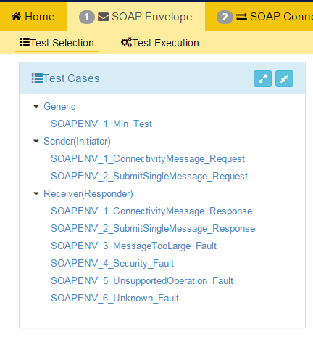
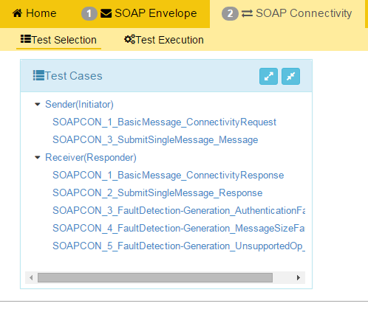
Test Case List

Slide 16
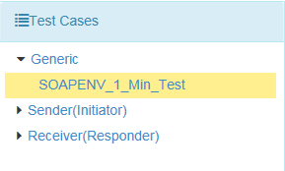
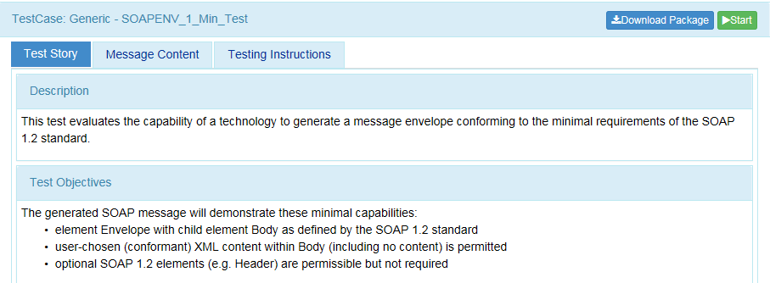
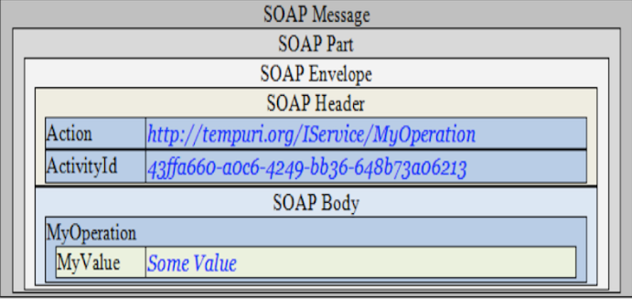
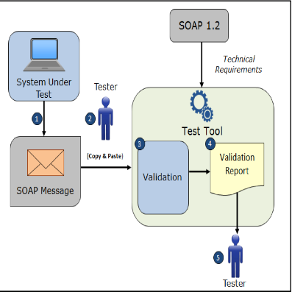
SOAP Envelope Testing Quick Guide
SOAP Envelope testing page
The SOAP Envelop Testing ensures SOAP envelopes are correctly formed, validating the conformance of the messages to the requirements in the SOAP and Transport specifications.
1
2
Open NIST Immunization Test Suite tool using link: http://hit-dev.nist.gov:8098/iztool/#/home
and click on ‘SOAP Envelope’ tab.
Under ‘Test Selection’ Select a ‘Test Case’
4
3
A ‘Test Story’ will appear once a test step is selected.
Point arrow down to select a test step.
6
Click on ‘Start ‘
4
Select “Message Content” .
5
Select “Testing Instructions” to gain additional information on how System Under Test (SUT) generates a SOAP message envelope.

Slide 17
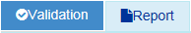
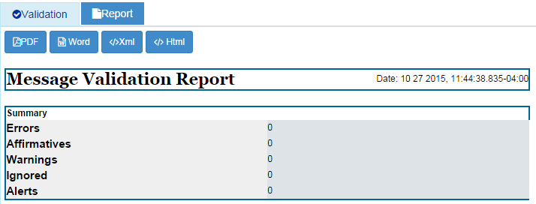
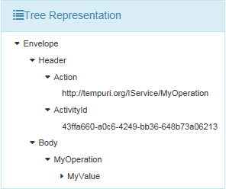
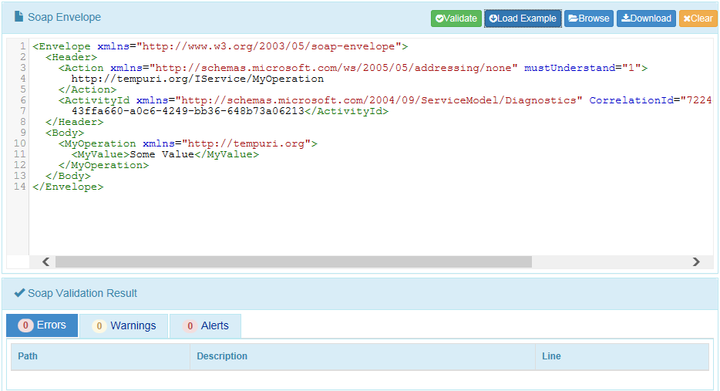
SOAP Envelope Testing: Other Utilities
SOAP Envelope Validation page
This page validates any Immunization message created by the EHR. It is disassociated from a test script, test case, or specific content (test data).
7
Clicking ‘Start’ will generate the ‘Test Execution’ tab.
8
Confirm ‘Validation’ is highlighted.
10
Click on ‘Report’ to generate a Message Validation Report.
9
Insert a HL7 message by clicking ‘Load Example’.

Slide 18
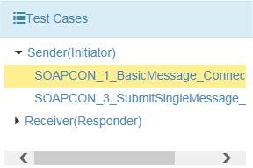
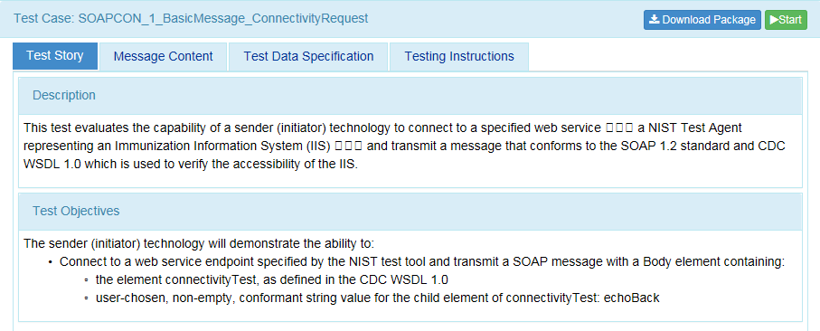
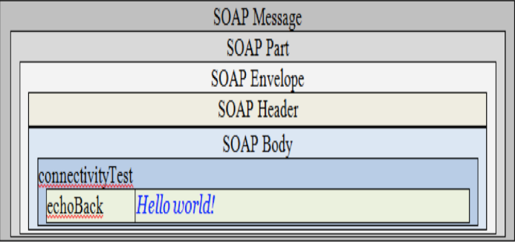
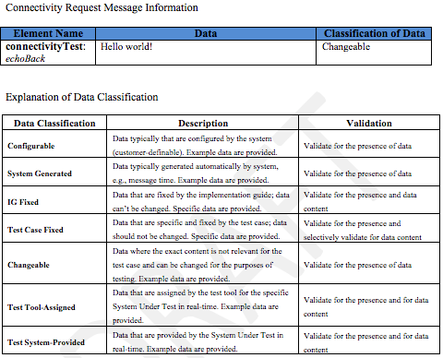
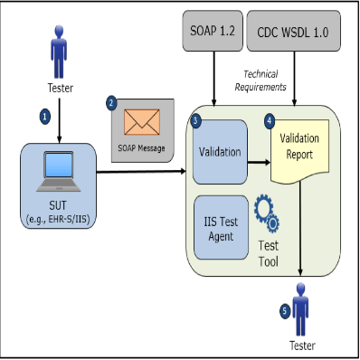
SOAP Connectivity Testing Quick Guide
SOAP Connectivity testing page
The SOAP Connectivity Testing evaluates valid SOAP connectivity, the ability to send and receive SOAP messages, validating the conformance of the messages to the requirements in the SOAP and Transport specifications.
1
2
Open NIST Immunization Test Suite tool using link: http://hit-dev.nist.gov:8098/iztool/#/home
and click on ‘SOAP Connectivity’ tab.
Under ‘Test Selection’ Select a ‘Test Case’
3
Point arrow down to select a test step.
4
A ‘Test Story’ will appear once a test step is selected.
7
Click on ‘Start ‘
8
Please collect and validate your incoming/outgoing messages in the Stage 1: SOAP Envelope
5
6
Select “Message Content”. Select “Test Data Specification”.
Select “Testing Instructions”.

Slide 19
NIST Immunization Test Suite (2016)
HL7 v2.5.1 Testing

Slide 20
Messaging Standard – Supported Profiles
HL7 2.5.1 Immunization Implementation Guide Release 1.5
HL7 2.5.1 Immunization Implementation Guide Release 1.5, Addendum
All 8 Profiles Supported
VXU^V04
Z22 - SEND UNSOLICITED IMMUNIZATION UPDATE USING A VXU
ACK
Z23 - RETURN AN ACKNOWLEDGEMENT
QBP^Q11
Z34 - REQUEST A COMPLETE IMMUNIZATION HISTORY
Z44 - REQUEST EVALUATED IMMUNIZATION HISTORY AND FORECAST QUERY PROFILE
RSP^K11
Z31 - RETURN A LIST OF CANDIDATES PROFILE
Z32 - RESPONSE PROFILE – RETURN COMPLETE IMMUNIZATION HISTORY
Z33 - RETURN AN ACKNOWLEDGEMENT WITH NO PERSON RECORDS
Z42 - RETURN EVALUATED HISTORY AND FORECAST

Slide 21
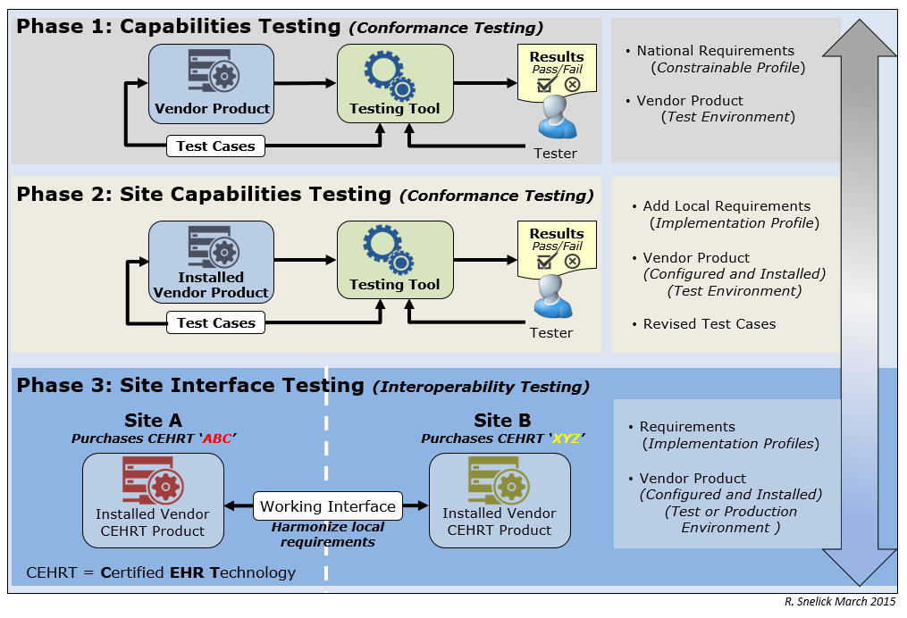
Testing Tiers

Slide 22
HL7 Content Testing: Test Tool Operation Modes
Testing the Sender (Message Creation)
Context-free Testing
Provides a simple and convenient method for testing message structure and most vocabulary
The context-free operational mode validates any message created by the EHR
It is disassociated from a test script, test case, or specific content (test data)
Good for site-testing
Context-based Testing (Use for Certification Testing)
Test Cases provided
Context (specific Test Scenario, etc.) is known to validation tool
Expands the scope of testing
Used in product certification testing
Testing the Receiver (Incorporation)
Incorporation of message and associated functional requirements
Employs inspection testing (Juror Document)

Slide 23
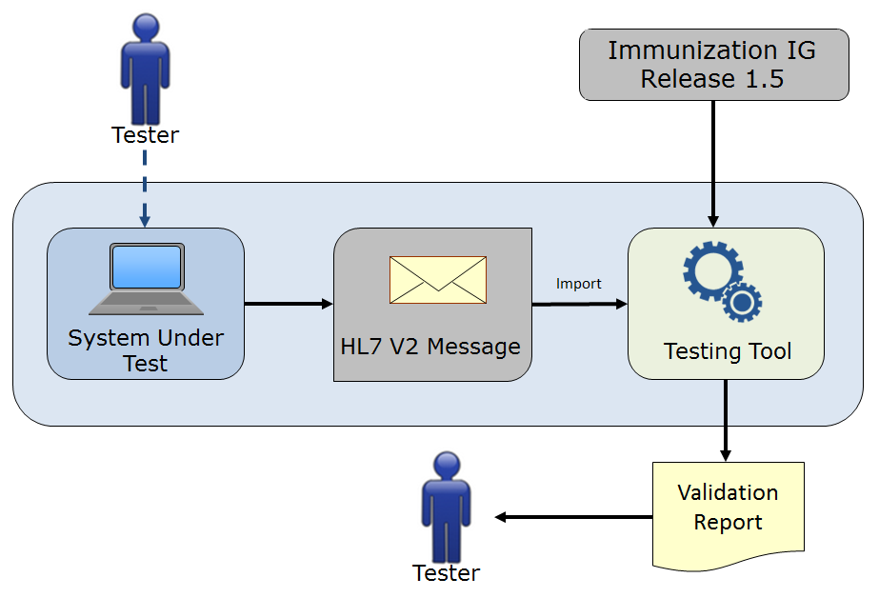
Context-free Testing: HL7 Content
No Test Cases provided
Context (Test Scenario, etc.) is unknown to validation tool
May be used to test any message created by an EHR
Provides a simple and convenient method for testing message structure and most vocabulary
Typically is not used for certifying EHR technologies for the ONC certification criteria, but may be used for certification testing in specific instances (the Tester must perform visual inspection to validate content of message)

Slide 24
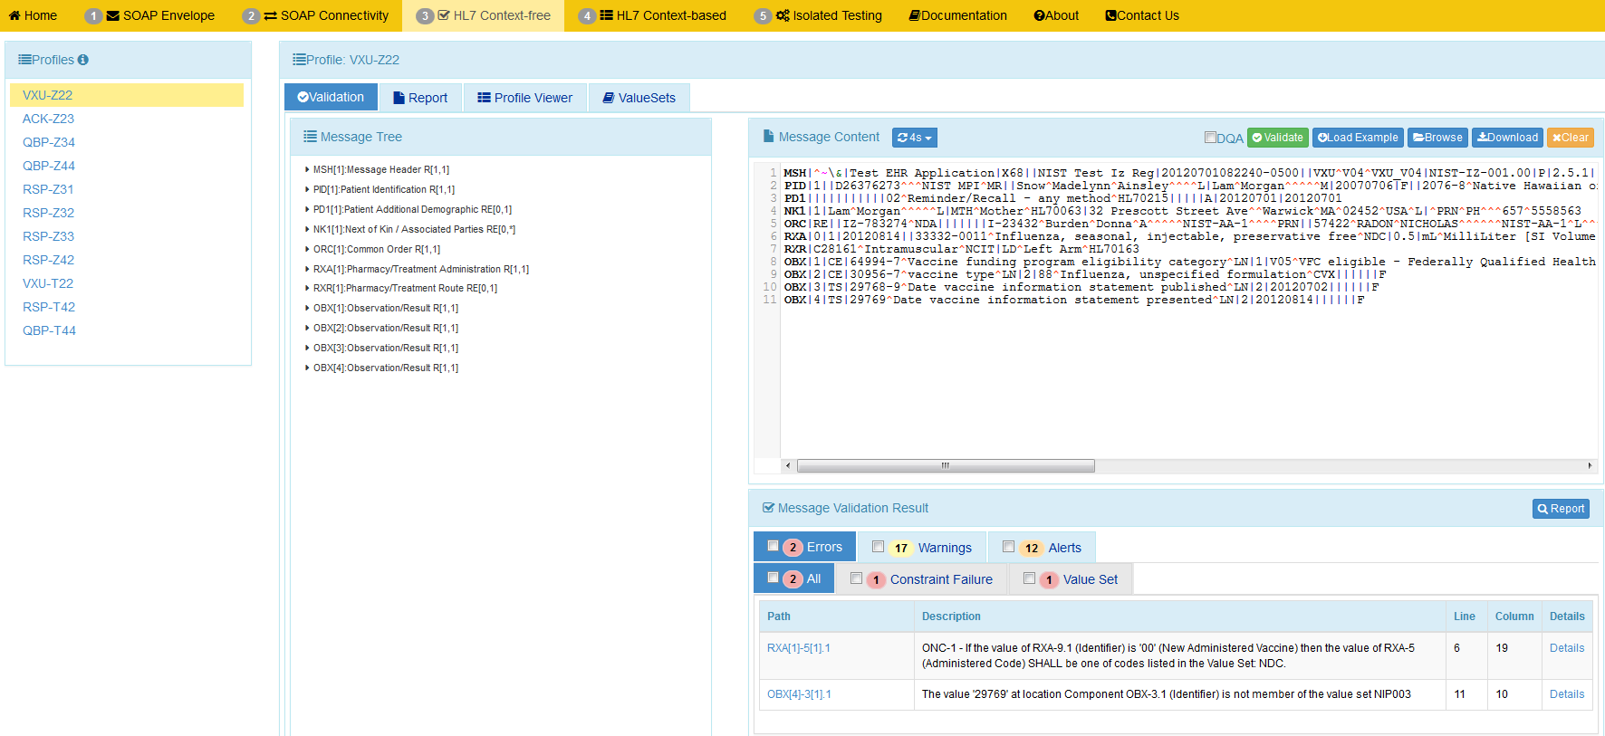
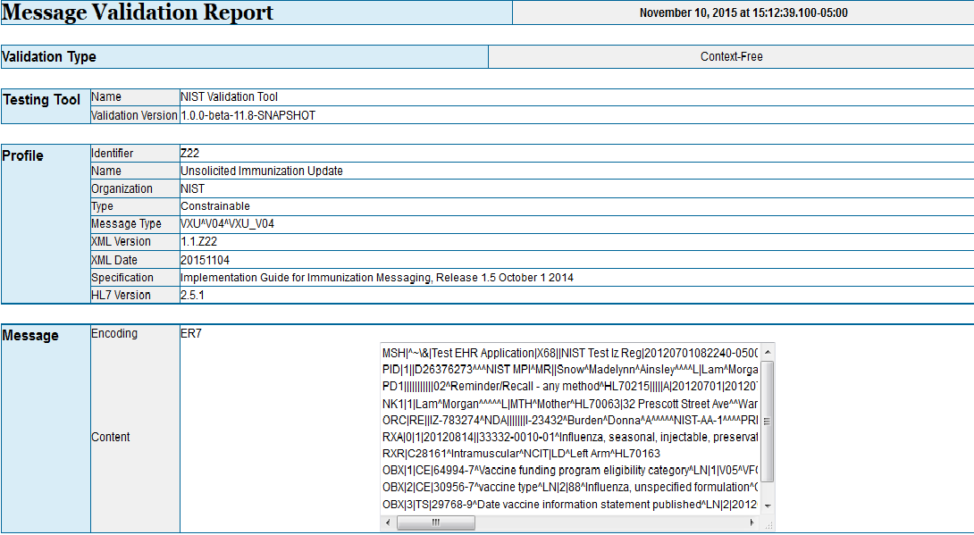
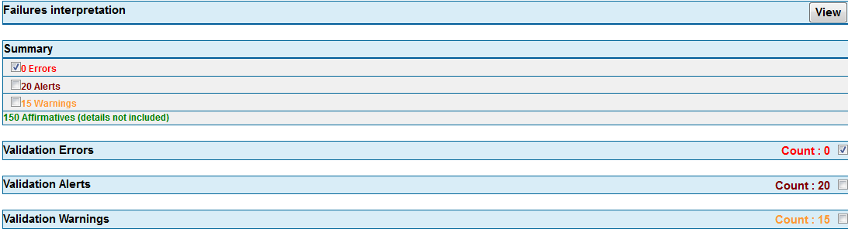
Context-free Testing Quick Guide
Context-free Validation page
This page validates any Immunization message created by the EHR. It is disassociated from a test script, test case, or specific content (test data).
1
2
Open NIST Immunization Test Suite Tool using link: http://hl7v2-iz-r1.5-testing.nist.gov and click on ‘HL7 Context-free’ tab.
Select a ‘Conformance Profile’ to test an HL7 message against.
4
Copy/paste or click on Browse Message button to upload test message into Message Content window.
3
Select the ‘Validation’ tab.
5
Validation results appear. If message failed, errors display.
6
Click on ‘Report ‘icon to display Message Validation Report.

Slide 25
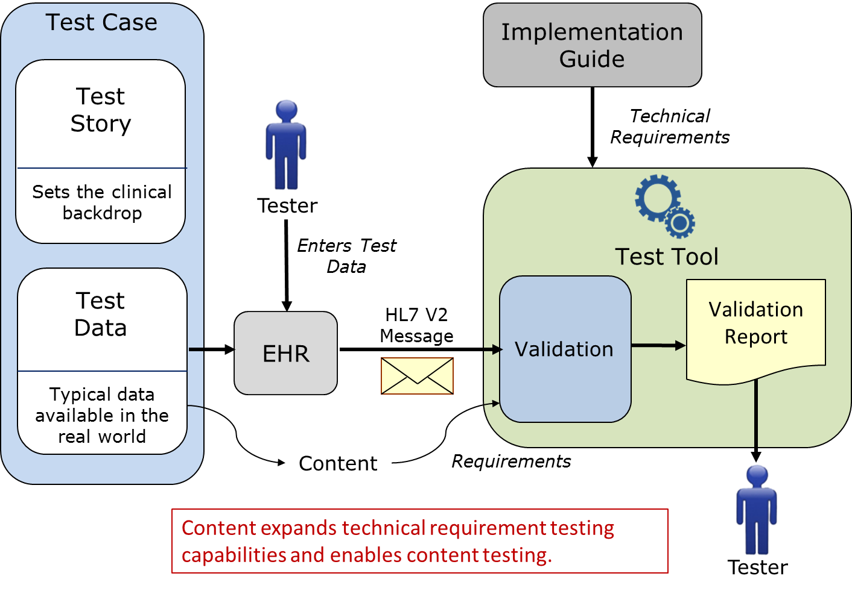
Context-based Testing (Sending Application)
Used for ONC Certification
Note: EHR-S is the SUT in this Example

Slide 26
Context-based Testing
The context-based operational mode validates messages associated with a given test script that includes data for a specific test scenario
The EHR creates a message that corresponds to the test data provided in the test script – Supports different use cases (Administered, Refusal, etc.)
Testing will include the technical requirements and content-specific requirements specified in the test case
Context (specific Test Scenario, etc.) is known to validation tool
Provides a method for testing/assessing a message for all conformance requirements of an Implementation Guide
Is used for certifying EHR technologies for the ONC certification criteria
Significantly expands the scope of testing
Usage: Required, but may be empty (RE), Conditionals (C)
Cardinality: Ranges
Length: Ranges
Vocabulary
Helps Interpretation and Use of the Standards

Slide 27
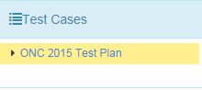
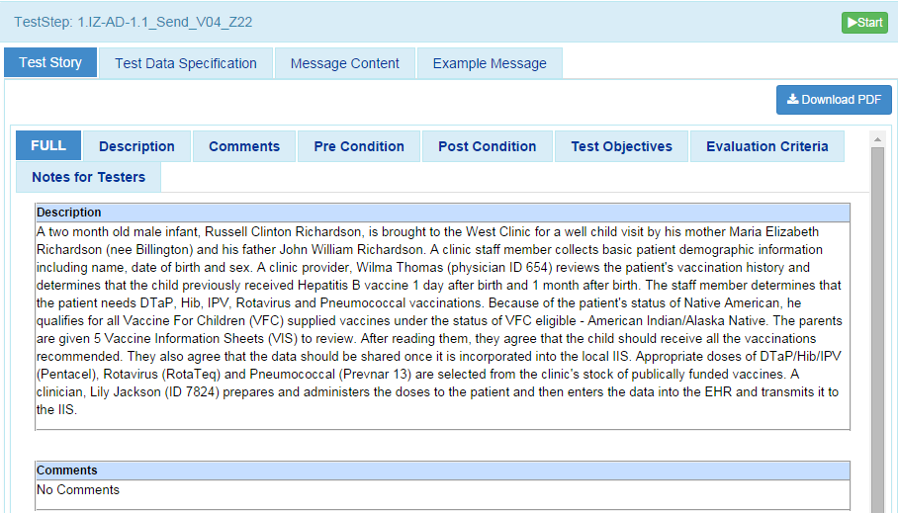
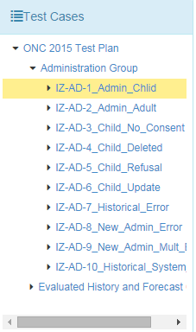
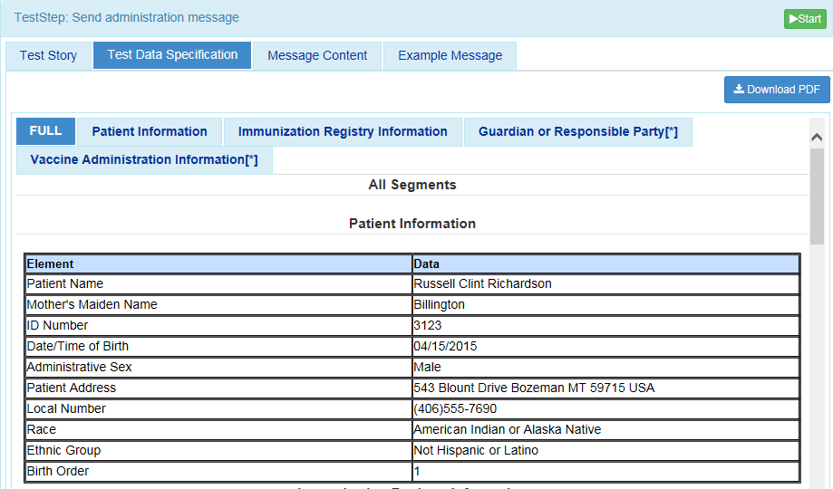
Context-based Testing Quick Guide
Context-based Testing page
This page validates messages associated with a given test script that includes a specific Immunization test scenario. Testing will include the technical requirements and content-specific requirements specified in the Test Case.
2
1
Select ‘Test Selection’ to view or select a test case.
Open NIST Immunization Test Suite tool using link: http://hl7v2-iz-r1.5-testing.nist.gov and click on ‘HL7 Context-based’ tab.
3
Arrow down ‘Administration Group’ to choose a test case A description of the test case will be displayed.
4
5a
Select ‘Test Data Specification’. Relevant real world data is displayed.
Highlight a test step. The description for the test step will be displayed. As a part of the ‘Test Story’.
5b
Create the test message with the EHR or IIS technology using the test data provided in the “Message Content.” The “Example Message” tab also aids in creating the test message.
6
Click ‘Start’

Slide 28
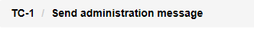
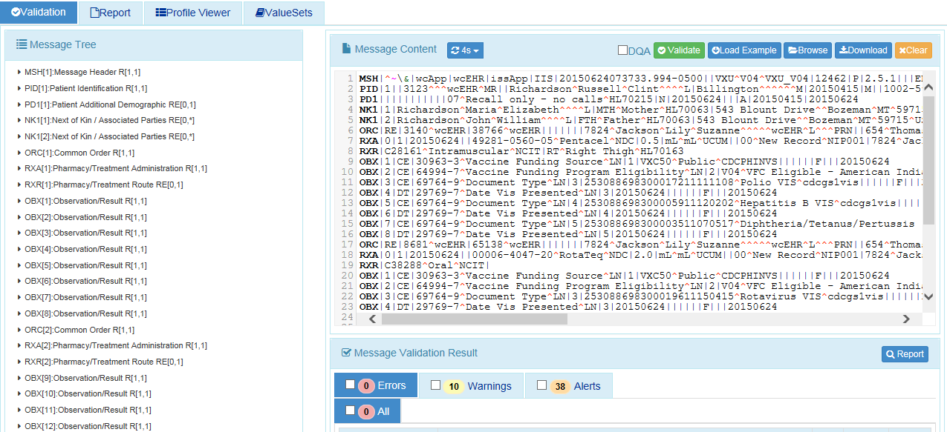
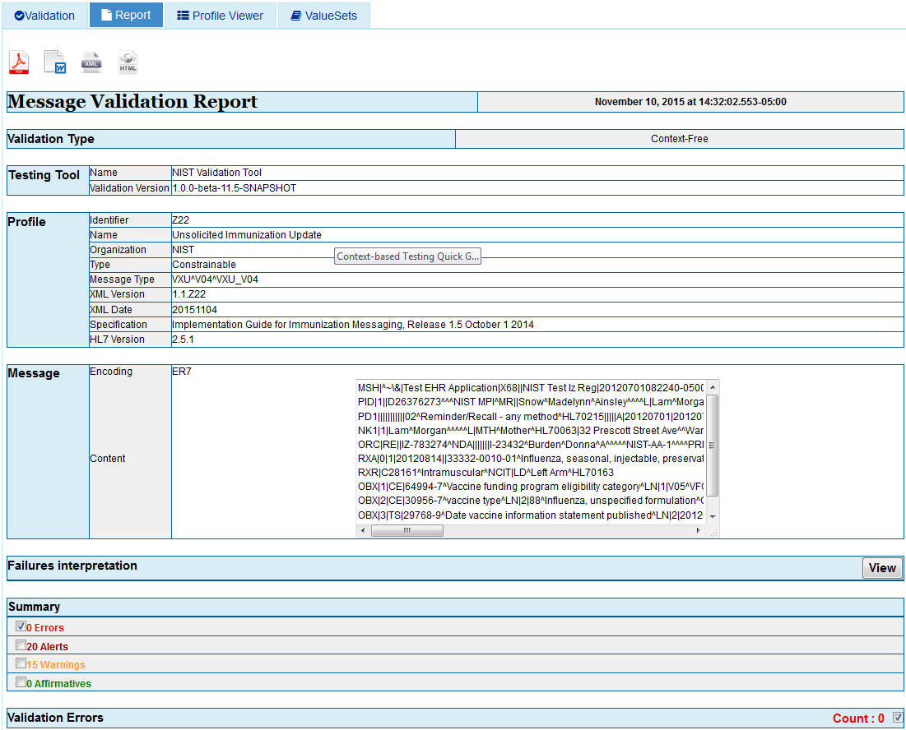
Context-based Testing Quick Guide
7
Context-based Validation page
This page validates any Immunization message created by the EHR. It is disassociated from a test script, test case, or specific content (test data).
Selecting ‘Start’ will load the test step and send you to the ‘Test Execution’ tab.
8
‘The Message Step will be displayed
9
Copy/paste or click Browse Message button to upload test message into the Message Content window.
10b
The ‘Report’ Tab can also be selected to generate a ‘Message Validation Report’
11
10a
Validation results appear. If message failed, errors display.
Click on ‘Report ‘icon to display Message Validation Report.

Slide 29
Test Case Overview
Example use cases and messages
Provides realistic scenarios
Demonstrates desired interpretation and implementation of the standard—”brings it all together”
Implementers like to copy what they see—”we provide the example we want them to copy!”
Test Plan
Scenario/Test Cases
Test Story
Test Data
Test Objectives
Pre-condition/Post Conditions
Evaluation Criteria and Notes to Testers
Poses questions to common real world scenarios and provides answers
Dynamic “living” test cases on test site

Slide 30
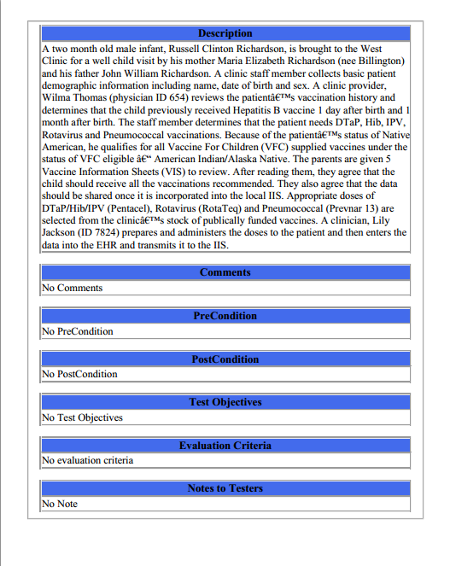
Test Cases: Test Story
Each Test Case includes a narrative Test Story that describes a real world situation and provides context for each Test Step
Example Test Data document: Test Case: IZ-AD-1_Admin_Child – 1.IZ-AD-1.1_Send_V04_Z22

Slide 31
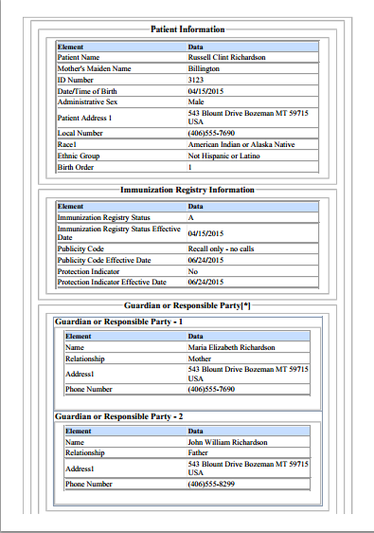
Test Cases: Test Data Specification
Each Test Case includes a Test Data Specification for each Test Step for which test data are expected to be entered into the HIT Module
Lists data associated with the Test Story
Consists of typical information found in the clinical setting
Along with the Test Story, provides sufficient information to be entered into the HIT Module for the Test Step
A test message is generated using these data and the HIT Module functions
Example Test Data document: Test Case: IZ-AD-1_Admin_Child – 1.IZ-AD-1.1_Send_V04_Z22
31
Notes:
31

Slide 32
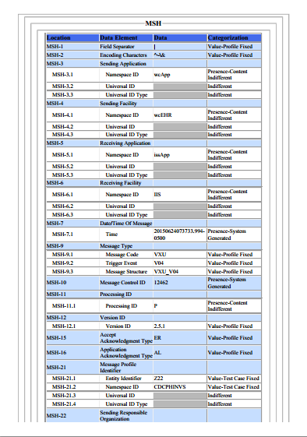
Test Cases: Message Content
Each Test Case includes a Message Content Data Sheet that shows a conformant message instance for each Test Step
The Category of the test data is listed in the Categorization column for each Data Element Location
Example Test Data document: Test Case: IZ-AD-1_Admin_Child – 1.IZ-AD-1.1_Send_V04_Z22
32
Notes:
32

Slide 33
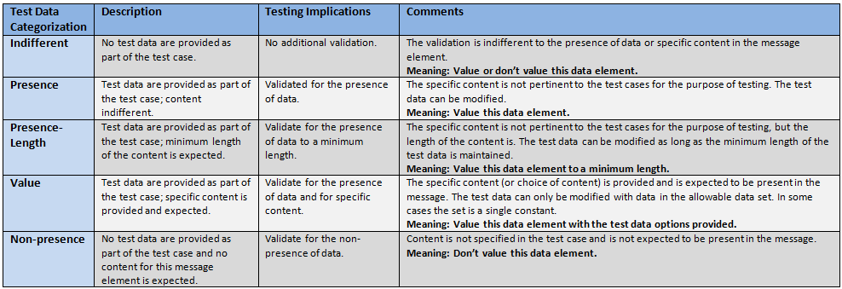
Test Data Categorization and Validation
The Message Content Data Sheet shows the Categorization of the test data that are provided for each Location
Each Test Data Category
Defines the criteria that are used by the test tool to assess the test data that populate each element in a message
Tells the Tester if the test data in a specific field can be changed, the source of the test data, and to what level of precision the validation tool will assess the data
Important point—some data can be modified, e.g., “Presence”

Slide 34
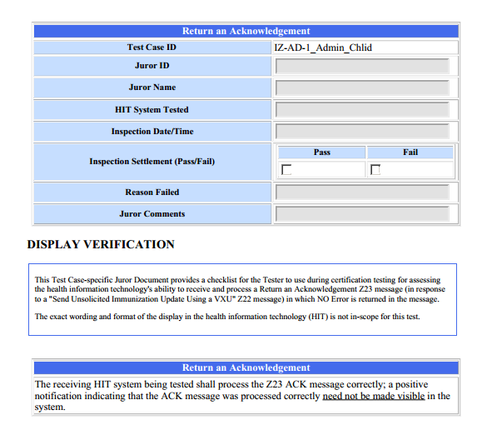
Test Cases: Juror Document
Each Test Case includes a Juror Document for the Receive or Response Test Step
Example Test Data document: Test Case: IZ-AD-1_Admin_Child – 2.IZ-AD-1.2_Receive_ACK_Z23
34
Notes:
34

Slide 35
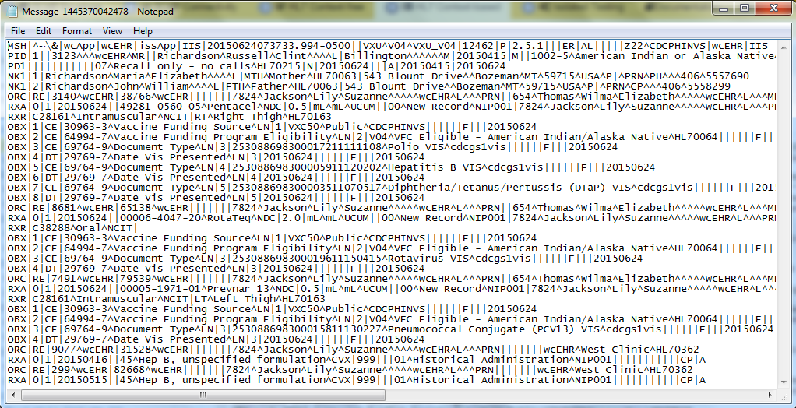
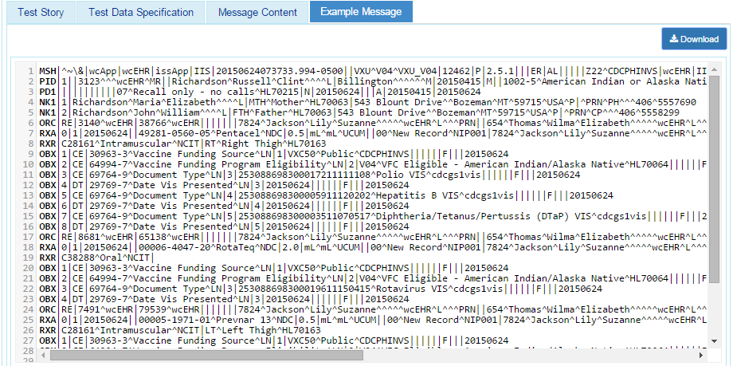
Test Cases: Example Messages
Each Test Case includes an Example Message instance for each Test Step
These example messages demonstrate use and interpretation of the standards
Example Test Data document: Test Case: IZ-AD-1_Admin_Child – 1.IZ-AD-1.1_Send_V04_Z22
35
Notes:
35

Slide 36
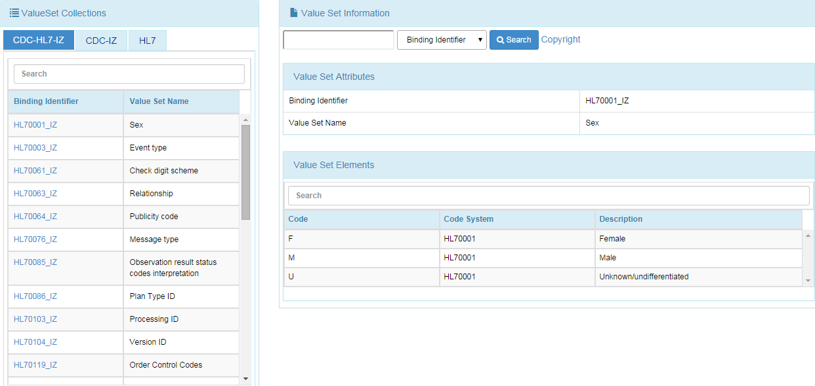
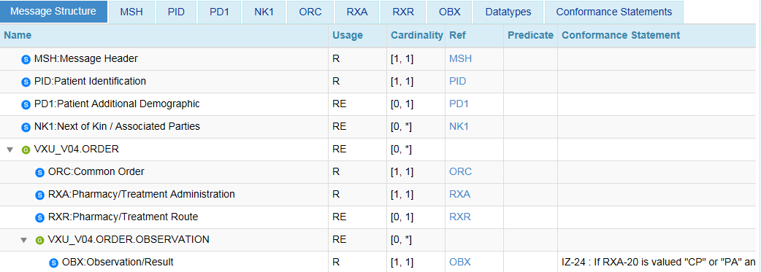
Profile Viewer and Vocabulary Viewer
Profile Viewer page
This page allows tester to view data element information including usage, cardinality, data type, length, table, condition predicate and conformance statements.
Value Sets page
This page provides the ability to browse the vocabulary requirements. Search capabilities are provided and include searching on value, table name, table ID and description.
1
2
Select the ‘Profile Viewer’ tab.
Select the ‘Value Sets’ tab.
Notes:
Fix all images; Sheryl commented too small to read

Slide 37
NIST Immunization Test Suite (2016)
Understanding the Validation Results

Slide 38
Classification of Validation Detections
Classification | Description
Errors | Indicates non-conformance to a requirement. Errors do constitute a failed validation An EHR Product will fail certification if any of the validation reports indicate an Error (unless the Error can be proved to be a false negative—NIST can be consulted to remediate)
Warnings | Provides information about potential missing support for a requirement or recommendation. Warnings do not constitute a failed validation
Alerts | Provides information about how the validation verifies or does not verify requirements. For example, the specification may provide a value set binding to an element but the value set is empty. Therefore, the user is alerted to the fact that no meaningful validation can be performed. Alerts do not constitute a failed validation
Affirmatives | Provides an indication of a positive outcome to a validation assertion Affirmatives display only as user preference, not by default

Slide 39
Detection Categories
Structure Validation | Content Validation
R-Usage | Constraint Failure add content failure
X-Usage | Content (Based on Test Cases)
W-Usage | Predicate Failure – Usage determined by a Conditional
RE-Usage | Constraint Spec Error
Cardinality | Predicate Spec Err
Null-cardinality | Value Set Validation
Length | EVS
Format | PVS
Extra | Code Not Found
UnescapedSeparator | VS Not Found
Unexpected | Empty VS
InvalidContent | VS Error
 | VS No Validation
 | Coded Element
BLUE = Not relevant for ONC Certification

Slide 40
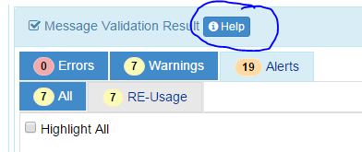
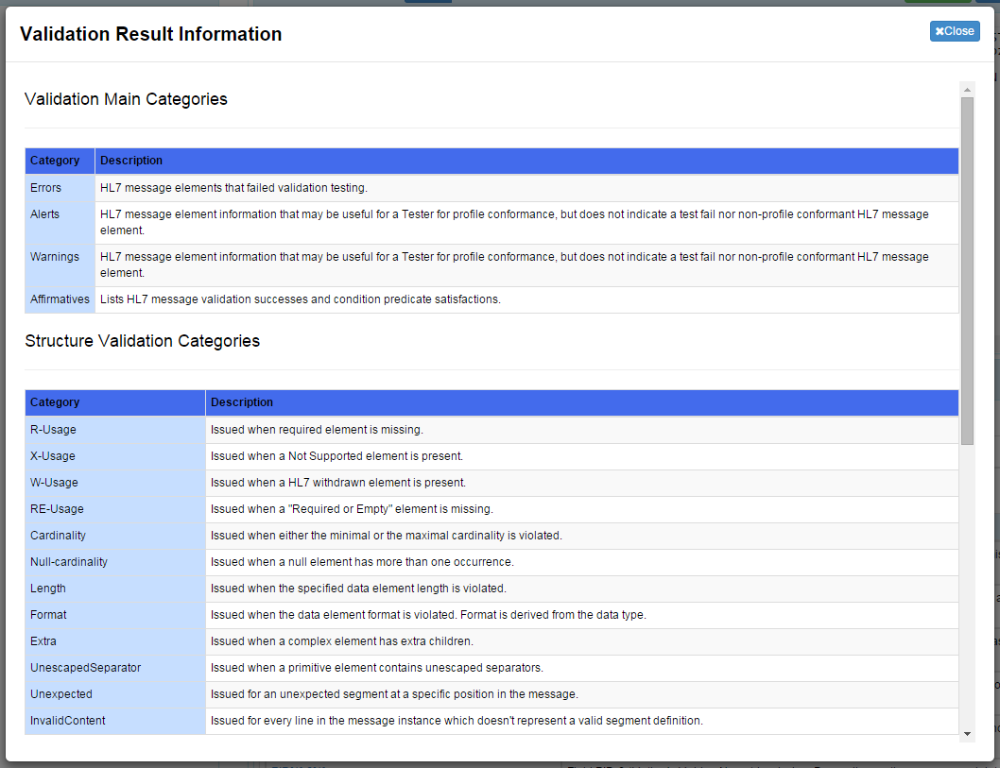
Validation Detections: Help

Slide 41
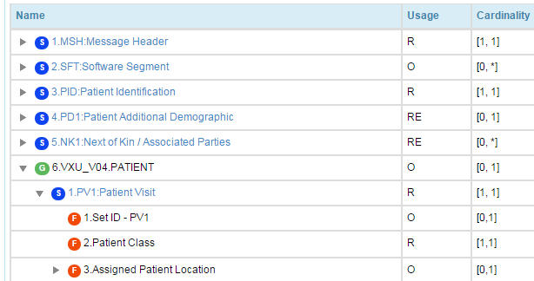
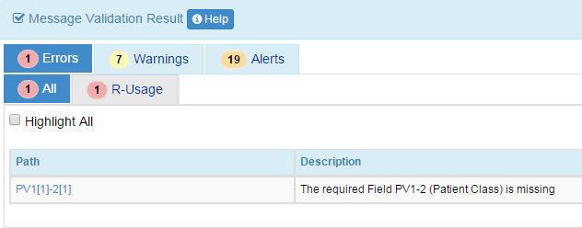
Validation Policy for Optional Elements
Primitive Elements with Optional Usage generates no detections
Complex Elements with Optional Usage follows the base standard rules (if the element is present in the message instance). That is, if an implementer decides to support Optional Usage Elements, then they need to follow the base standard requirements for that Element.
Example, if the PV1 segment is included, then PV1-2 SHALL be valued since it is Required.
PV1|XXX||||| (will generate and error). This is a Certification Error.

Slide 42
NIST Immunization Test Suite (2016)
Content Testing—Test Data Categories

Slide 43
Test Data Categorization and Validation
The Message Content Data Sheet shows the Categorization of the test data that are provided for each Location
Each Test Data Category
Defines the criteria that are used by the test tool to assess the test data that populate each element in a message
Tells the Tester if the test data in a specific field can be changed, the source of the test data, and to what level of precision the validation tool will assess the data
Important point—some data can be modified, e.g., “Presence”

Slide 44
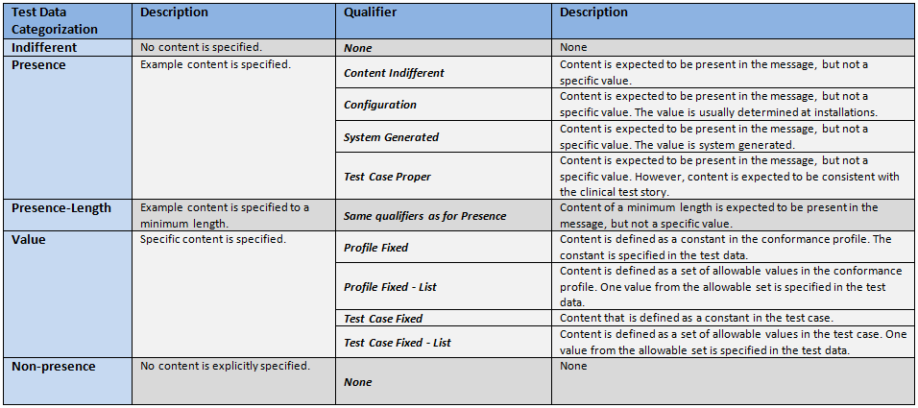
Test Data Categorization and Validation (cont’d)
Qualifiers enable refinement of the Test Data Category, providing additional information to the Tester about the source of the data and the expectations of the data element
The Qualifier does not impact the validation of the data element

Slide 45
Test Category Assessment Table (Examples)
Element | Usage | Test Data | Test Category | Conformity Assessment | Data in Message | Validation Result
PID-5.3 (Middle Name)* | RE | Donna | Presence-Content-Indifferent | Required | <Empty> | Fail
PID-5.3 (Middle Name) | RE | Donna | Presence-Content-Indifferent | Required | Donna | Pass
PID-5.3 (Middle Name) | RE | Donna | Presence-Content-Indifferent | Required | Sue | Pass
PID-5.3 (Middle Name) | RE | Donna | Presence-Length-Content-Indifferent | Required Min Length = 5 | Victoria | Pass
PID-5.3 (Middle Name) | RE | Donna | Presence-Length-Content-Indifferent | Required Min Length = 5 | Sue | Fail
PID-5.3 (Middle Name) | RE | Donna | Value-Test Case Fixed | Required Value = Donna | Donna | Pass
PID-5.3 (Middle Name) | RE | Donna | Value-Test Case Fixed | Required Value = Donna | Sue | Fail
MSH-9.2 (Trigger Event) | R | V04 | Value-Profile Fixed | Required Value = V04 | V04 | Pass
* Actual description is “Second and Further Given Names or Initials Thereof”

Slide 46
Coded Element Examples
Example Message Segment:
RXA|0|1|20150624||49281-0560-05^Pentacel^NDC|0.5|mL^mL^UCUM||00^New Record^NIP001|7824^Jackson^Lily^Suzanne^^^^^wcEHR^L^^^PRN|^^^wcEHR||||526434|20150722|SKB^GlaxoSmithKline^MVX|||CP|A
Element | Test Data | Test Category | Conformity Assessment
RXA.5.1 | 49281-0560-05 | Value-Test Case Fixed | Content must be present and exactly “49281-0560-05”
RXA.5.2 | Pentacel | Presence-Test Case Proper | Content must be present and indicate a value equivalent to Pentacel
RXA.5.3 | NDC | Value-Test Case Fixed | Content must be present and exactly “NDC”
Example Message Segment:
RXR|C28161^Intramuscular^NCIT|RT^Right Thigh^HL70163
Element | Test Data | Test Category | Conformity Assessment
RXR-1.1 | C28161 | Presence-Content Indifferent | Content is expected to be present in the message, but not a specific value
RXR-1.2 | Intramuscular | Presence-Test Case Proper | Content must be present and indicate a value equivalent to the code in RXR-1.1
RXR-1.3 | NCIT | Value-Profile Fixed | Content is defined as a constant in the profile. The constant is specified in the test data; value must be present and exactly “NCIT”

Slide 47
NIST Immunization Test Suite (2016)
HL7 Context-free DQA Testing

Slide 48
What is Data Quality Assurance (DQA) ?
DQA is an open source tool for detecting potential data quality issues in immunization messages, such as
Malformed, unlikely, or improbable components of name, address, phone, etc.
Internal inconsistencies (e.g. patient birthdate after vaccine admin date)
Code related issues (deprecation, conflicts with admin date, etc.)
DQA detects approximately 500 issues, including data quality and HL7 message conformance issues
NIST uses the DQA only for detecting (~50) data quality related issues
HL7 conformance issues are already detected by NIST HL7 message validation
By default all data quality detections are turned off
Users can choose which data quality detections they want turned on
Detected quality issues reported along side of HL7 conformance issues after message validation

Slide 49
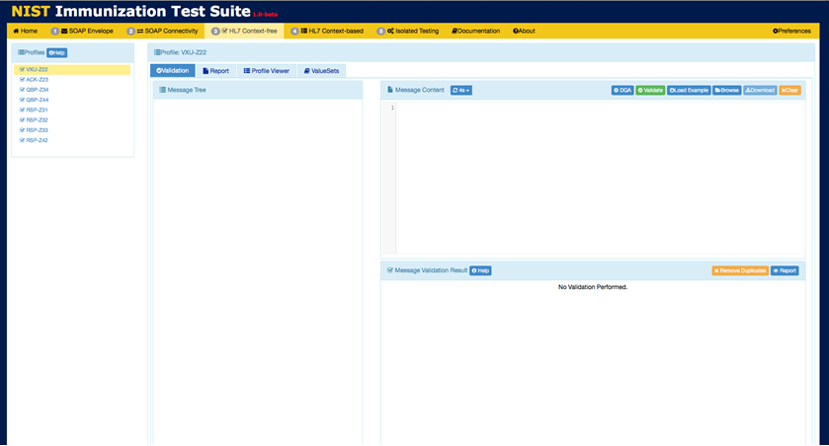
Data Quality Assurance (DQA)
Objectives | Informative Reference
Select the VXU-22 profile. Locate ‘DQA’ button Obtain a data quality validation. | In addition to HL7 message profile-based conformance validation, the user may also select “data quality validation” (using DQA) in order to produce additional report items related to any detected “quality issues” identified during validation. DQA (Data Quality Assurance) is an open source tool for detecting quality problems in Immunization messages (refer to the slide “What is DQA” for more details)
1
Select ‘VXU-222’
Profile.
2
Select ‘DQA’
NOTE: The data quality validation is an option only for use with the VXU-Z22 profile, and only for the quality issues manually selected by clicking on the DQA button (next to the Validate button in the Message Content Window).

Slide 50
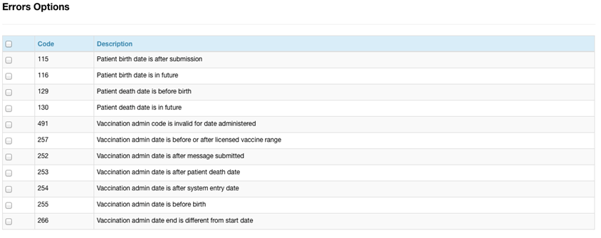
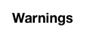
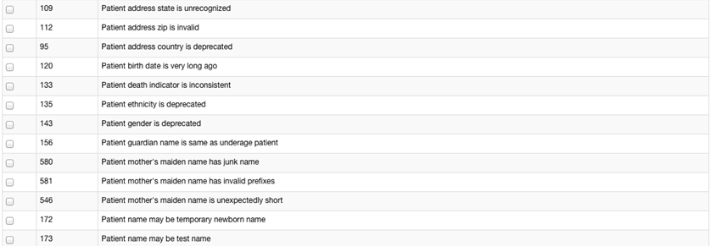
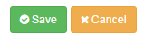
Data Quality Assurance (continued…)
Objectives | Informative Reference
Review list of available data quality issues which can be detected Use Select All or individually select Errors/Warnings to detect Use the Save button to activate the selected data quality issues Validate the message and view the Report | After selecting the DQA button, a list of data quality issues will be displayed. The issues are grouped into two categories, Errors and Warnings, based on severity. The user may choose to detect all Errors and Warnings via the Select All option, or individually.
3
Select any error option to detect.
4
Select any Warning option to detect.
5
Select ‘Save’ located at the top right of the DQA Options window.

Slide 51
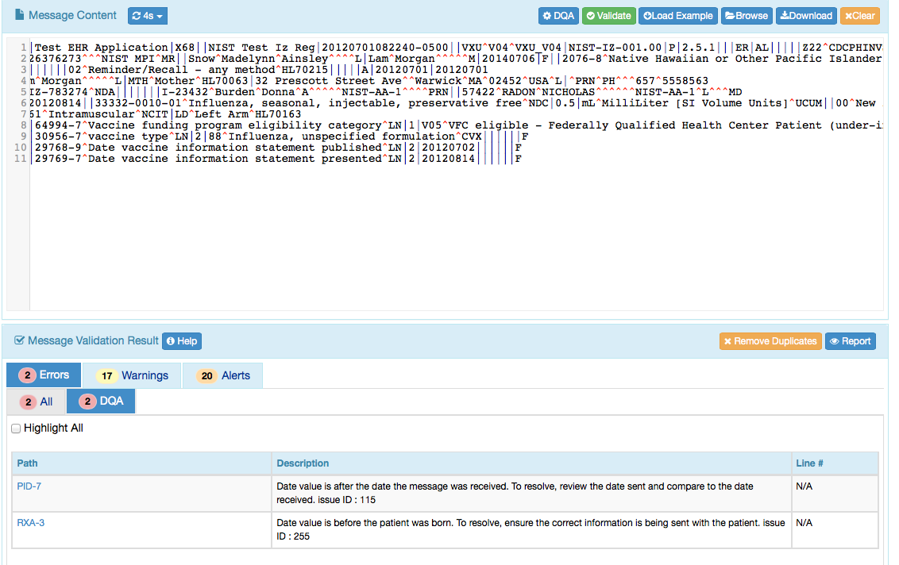
Example of DQA reported issues
6
Click the ‘Validate’ button to load validation results in the Message Validation Window.
7
Select the ‘DQA’ tab to display only DQA validation errors.

Slide 52
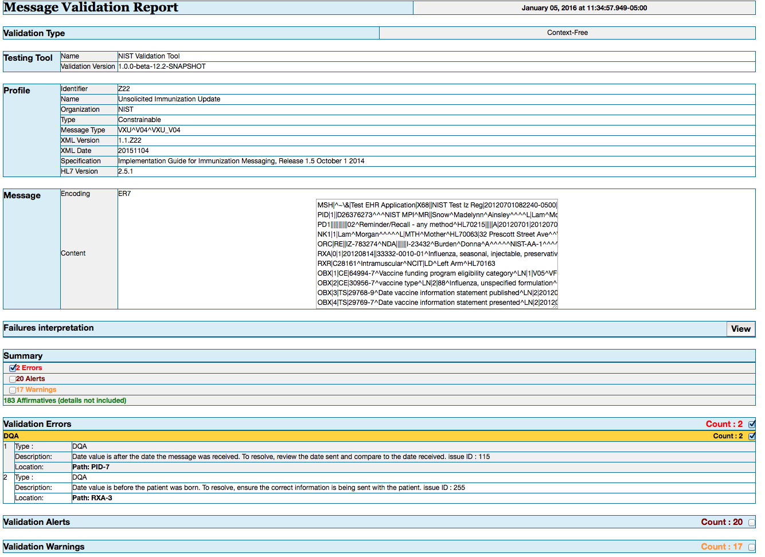
DQA Message Validation Report
8
The Message Validation Report displays the Validation Errors produced while performing Data Quality Assurance.

Slide 53
NIST Immunization Test Suite (2016)
ONC 2015 Health IT Certification

Slide 54
ONC Final Rule Criterion - Immunizations
§170.315(f)(1) Transmission to immunization registries
Evaluates the capability for a Health IT Module to electronically create immunization information for electronic transmission using the Immunization Messaging Guide and associated Addendum, with CVX codes for historical vaccines and National Drug Code Directory codes for administered vaccines
Evaluates the capability for a Health IT Module to enable a user to request, access, and display a patient’s evaluated immunization history and forecast from an immunization registry with information from the Health IT Module, if applicable, using the Immunization Messaging Guide and associated Addendum
Referenced Standards
§170.205 Content exchange and implementation specifications for exchanging electronic health information
(e)(4) Standard. HL7 2.5.1 Implementation specifications.
HL7 2.5.1 Implementation Guide for Immunization Messaging, Release 1.5
HL7 Version 2.5.1 Implementation Guide for Immunization Messaging (Release 1.5)—Addendum, July 2015
§170.207 Vocabulary standards for representing electronic health information
(e)(2) Standard. HL7 Standard Code Set CVX -- Vaccines Administered, updates through August 17, 2015
(e)(4) Standard. National Drug Code Directory– Vaccine Codes, updates through August 17, 2015
Note: The ONC certification criterion does not specify use of a transport standard; therefore, testing for this criterion does not require Health IT Modules to be certified to any transport standards

Slide 55
Messaging Standard – Supported Profiles
HL7 2.5.1 Immunization Implementation Guide Release 1.5
HL7 2.5.1 Immunization Implementation Guide Release 1.5, Addendum
All 8 Profiles Supported
VXU^V04
Z22 - SEND UNSOLICITED IMMUNIZATION UPDATE USING A VXU
ACK
Z23 - RETURN AN ACKNOWLEDGEMENT
QBP^Q11
Z34 - REQUEST A COMPLETE IMMUNIZATION HISTORY
Z44 - REQUEST EVALUATED IMMUNIZATION HISTORY AND FORECAST QUERY PROFILE
RSP^K11
Z31 - RETURN A LIST OF CANDIDATES PROFILE
Z32 - RESPONSE PROFILE – RETURN COMPLETE IMMUNIZATION HISTORY
Z33 - RETURN AN ACKNOWLEDGEMENT WITH NO PERSON RECORDS
Z42 - RETURN EVALUATED HISTORY AND FORECAST

Slide 56
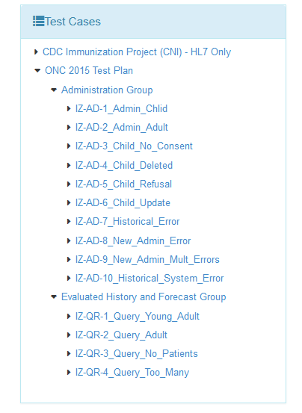
Test Plans and Associated Test Cases and Test Steps
ONC 2015 Certification Test Plan
Designed for ONC 2015 Edition certification testing
Consists of two Groups of Test Cases
10 Administration Test Case
4 Evaluated History and Forecast Test Cases
Provides Test Steps containing the test data
Includes five of the profiles defined in the Immunization Messaging Guide Release 1.5, which are paired for the certification testing
Profile Pair | Message Pair | Description
Z22/Z23 | VXU^V04/ACK | Send Immunization/ACK
Z44/Z42 | QBP^Q11/RSP^K11 | Evaluated History & Forecast—Query/Respond OK (Found)
Z44/Z33 | QBP^Q11/RSP^K11 | Evaluated History & Forecast—Query/Respond NF (Not Found)
Z44/Z33 | QBP^Q11/RSP^K11 | Evaluated History & Forecast—Query/Respond TM (Too Many)

Slide 57
ONC 2015 Certification Test Plan
Test Cases | Message Created – Step 1 | Message Returned – Step 2
Administration Group | Send Administration Message | Consume ACK Message
IZ-AD-1_Admin_Child | IZ-AD-1.1_Send_V04_Z22 | IZ-AD-1.2_Receive_ACK_Z23
IZ-AD-2_Admin_Adult | IZ-AD-2.1_Send_V04_Z22 | IZ-AD-2.2_Receive_ACK_Z23
IZ-AD-3_No_Consent | IZ-AD-3.1_Send_V04_Z22 | IZ-AD-3.2_Receive_ACK_Z23
IZ-AD-4_Delete_Record | IZ-AD-4.1_Send_V04_Z22 | IZ-AD-4.2_Receive_ACK_Z23
IZ-AD-5_Refusal | IZ-AD-5.1_Send_V04_Z22 | IZ-AD-5.2_Recieve_ACK_Z23
IZ-AD-6_Update_Record | IZ-AD-6.1_Send_V04_Z22 | IZ-AD-6.2_Receive_ACK_Z23
IZ-AD-7_Historical_IIS-Error | IZ-AD-7.1_Send_V04_Z22 | IZ-AD-7.2_Receive_ACK_Z23
IZ-AD-8_Admin_IIS-Warning | IZ-AD-8.1_Send_V04_Z22 | IZ-AD-8.2_Receive_ACK_Z23
IZ-AD-9_Admin_IIS-2Warnings | IZ-AD-9.1_Send_V04_Z22 | IZ-AD-9.2_Receive_ACK_Z23
IZ-AD-10_Historical_IIS-SysError | IZ-AD-10.1_Send_V04_Z22 | IZ-AD-10.2_Receive_ACK_Z23
Evaluated History & Forecast Group | Send Query Message | Receive Response Message
IZ-QR-1_Query_Child | IZ-QR-1.1_Query_Q11_Z44 | IZ-QR-1.2_Response_K11_Z42
IZ-QR-2_Query_Adult | IZ-QR-2.1_Query_Q11_Z44 | IZ-QR-2.2_Response_K11_Z42
IZ-QR-3_Query_No_Patients | IZ-QR-3.1_Query_Q11_Z44 | IZ-QR-3.2_Response_NF_K11_Z33
IZ-QR-4_Query_Too_Many | IZ-QR-4.1_Query_Q11_Z44 | IZ-QR-4.2_Response_TM_K11_Z33

Slide 58
Administrative Test Group Overview
Administrative Test Group
Tests the EHR-S capability of: (1) Creating immunization messages based on Immunization Messaging Standard (Z22 Profile) and specific Test Data, and (2) Receiving acknowledgment messages based on the Immunization Messaging Standard (Z23 Profile).
All 10 test cases consists of 2 test steps: (1) Create Immunization Message (2) Receive Acknowledgment
Create Immunization Message | Create immunization message test steps are designed to test a broad scope of the immunization messages including new and historical administrations, refusals, combination vaccines, patient consent and various observations including VIS, VFC.
(2) Receive ACK | Receive acknowledgement test steps are designed to test the EHR-S capability to correctly handle application accept, application error, and application warning acknowledgements. A juror document is provided for inspection.

Slide 59
Immunizations Administration Testing Process
Immunization IG, Release 1.5, and Addendum
Immunization Data Entry
VXU Message & Direct Data Entry
HIT Module
(System under Test)
NIST Validation Tool (acting as IIS)
VXU Message
ACK Message Imported
ACK Message
VXU Message
Imported
ONC Certification Testing Scope
Test Step 1
Test Step 2
The HIT Module is the system being tested. The HIT Module is required to create VXU messages and consume ACK messages that conform to the referenced standards (see previous slides).
Test data can be entered into the HIT Module directly via the Module’s user interface or can be imported via an incoming message.
The HIT Module is expected to process the test data to create a VXU message. This message is imported into the testing tool for validation (Test Step 1 – Z22 VXU). The HIT Module is expected to consume an ACK message. This message is imported from the testing tool into the HIT Module (Test Step 2 – Z23 ACK).
Test data are available through the Test Tool via the Test Steps in the Test Cases. Each Test Step includes a Test Story that provides the context, a Test Data Specification that lists the test data, a Message Content Data Sheet that shows the conformant message (in a table format), and a Juror Document (for ACK Test Steps).

Slide 60

Testing Workflow Diagram (Test Step 1 – Z22 VXU)
This diagram shows
How the major steps of the create VXU message test are sequenced
When the Test Tool is to be used

Slide 61

Testing Workflow Diagram (Test Step 2 – Z23 ACK)
This diagram shows
How the major steps of the consume ACK message test are sequenced
When the Test Tool is to be used

Slide 62
Test Case 1: Immunization for Child
IZ-AD-1_Admin_Child
Purpose | Create administration message containing historical and new administrations for a child. Receive an application accept acknowledgement
Steps | High-level Test Objectives
Step 1: IZ-AD-1.1_Send_V04_Z22 Create Administration Message | Create record for a Child (Infant) 3 New Administration Immunizations (use NDC) 2 Historical Immunizations (use CVX) Next of Kin (multiple instances) Combination Vaccine Observations including: Patient Consent VIS – Vaccination Information Statement Funding Source VFC Eligible – Vaccine Funding for Children
Step 2: IZ-AD-1.2_Receive_ACK_Z23 Receive ACK | Receive valid application accept acknowledgement without error and transparent to end user

Slide 63
Vaccine Codes Required for Immunization Messages
2015 ONC Certification Testing Only
Codes from the NDC Directory are required for vaccines in new vaccine administered records in
Z22 VXU (send unsolicited immunization update message)
CVX codes are required for vaccines in vaccine historical records in
Z22 VXU (send unsolicited immunization update message)
Z42 RSP (return evaluated history and forecast message)
Example Scenario
A Z22 VXU message is transmitted from an EHR to an IIS with an NDC for a new vaccine administered
A query for an Evaluated Immunization History and Forecast (Z44 QBP message) is performed via the EHR the next day
The response for the Evaluated Immunization History and Forecast (Z42 RSP message) is transmitted from the IIS with a CVX code for the vaccine sent with an NDC in the Z22 VXU the day before, as this vaccine now exists as a historical record in the IIS

Slide 64
NDC Format
NDC has various formats for representing a concept
Published NDC codes are 10 digits with dashes (can be groups of 4-5, 3-4, 1-2, digits but always 10 total)
CMS created 11 digit unformatted (padded without dashes, always with 5-4-2, groups of digits with one of the 1st, 2nd, or 3rd component padded with a 0)
The problem of the 10 digit format is that they don’t often have the dashes and so can’t reliably be determined to match a given vaccine. This motivated the “normalization” to 11 characters.
11 digit format with dashes and padded. E.g., “CDC Vaccine Price List”
much of the vaccine used in the US is federally funded and ordering uses the 11 character with dash—this format was determine to be the most appropriate choice
The link in the ONC rule points to files that contain the 11 digit format with dashes and padded.
Bar codes are created that map to the NDC codes (Today’s NDC bar codes are unique). Bar codes contain a prefix, 10 digit NDC (no dashes), and a check digit
There are crosswalk tables to keep all of this straight and to be able to go from one format to another (Implementers may need to do this to meet their implementation choices)
Certification Requirements are to use the 11 digit format with dashes and padded
RXA-5.1 Example: 00006-4047-20^RotaTeq^NDC
Note 10 digit NDC code is 0006-4047-20 with the leading 0 added to the first component.
No other formats are acceptable for certification
If vendors wish to send an alternative code they may do so in the 2nd triplet of RXA-5
e.g., 00006-4047-20^RotaTeq^NDC^00006404720^RotaTeq^NDC
In this case the 11 digit padded without dashes format is used
First triplet must be NDC 11 padded with dashes
Vendors can represent the NDC codes internally in their HIT system in any manner they choose

Slide 65
Testing Acknowledgements
Test Cases 1-6 contain no Errors or Warnings
Nothing needs to be displayed or indicated by the EHR
It is invalid if an Error/Warning is indicated
ATLs should only be concerned if an error is raised
It is sufficient (at the discretion of the ATL) to only require 1 import of an acknowledgement containing no errors to warnings and confirm no that no Error or Warning is issued.
The EHR may indicate a valid incorporation but this is bad practice and highly unlikely.
Test Cases 7-10 Contain an Errors and/or Warnings
Meaning the ACK message structure is valid but the content of the ACK message reports that the responding system (e.g., IIS) had trouble processing the incoming message (whether it is valid or not)
Each ACK message needs to be imported into the EHR
The ATLs are to confirm that the EHR displays some indication that the responding system had an issue with the incoming message

Slide 66
Test Case 2: Immunization for Adult
IZ-AD-2_Admin_Adult
Purpose | Create administration message containing historical and new administrations for an adult Receive an application accept acknowledgement
Steps | High-level Test Objectives
Step 1: IZ-AD-2.1_Send_V04_Z22 Create Administration Message | Create record for an Adult 1 New Administration Immunization (use NDC) 2 Historical Immunizations (use CVX) Patient E-mail Address Observations including: Patient Consent VIS – Vaccination Information Statement Funding Source Not VFC Eligible – Vaccine Funding for Children
Step 2: IZ-AD-2.2_Receive_ACK_Z23 Receive ACK | Receive valid application accept acknowledgement without error and transparent to end user

Slide 67
Test Case 3: Immunization for Child but No Consent
IZ-AD-3_No_Consent
Purpose | Create administration message containing a new vaccine but consent is not given. Receive an application accept acknowledgement
Steps | High-level Test Objectives
Step 1: IZ-AD-3.1_Send_V04_Z22 Create Administration Message | Create record for a child 1 New Administration Immunization (use NDC) Patient Consent is not given (PD1-12 = Y) Test support for full first and middle name (Length >= 9) Observations including: VIS – Vaccination Information Statement Funding Source VFC Eligible – Vaccine Funding for Children
Step 2: IZ-AD-3.2_Receive_ACK_Z23 Receive ACK | Receive valid application accept acknowledgement without error and transparent to end user

Slide 68
Test Case 4: Previous Vaccination Deleted
IZ-AD-4_Delete_Record
Purpose | Create administration message intended to delete a previously documented vaccination due to user error. Receive an application accept acknowledgement
Steps | High-level Test Objectives
Step 1: IZ-AD-4.1_Send_V04_Z22 Create Administration Message | Complete information about a previously documented vaccination is requested Action Code is set to deleted (RXA-21 = D)
Step 2: IZ-AD-4.2_Receive_ACK_Z23 Receive ACK | Receive valid application accept acknowledgement without error and transparent to end user

Slide 69
Test Case 5: Refusal and Multiple Birth Indicator
IZ-AD-5_Refusal
Purpose | Create administration message that indicates a vaccine refusal for a twin. Receive an application accept acknowledgement
Steps | High-level Test Objectives
Step 1: IZ-AD-5.1_Send_V04_Z22 Create Administration Message | Create record for a child 3 New Administration Immunizations (use NDC) 1 Refused Immunization (use CVX, RXA-20 = RE, value RXA-18) Child is a twin, set multiple birth indicator and order Multiple Birth Indicator (PID-24 = Y) Birth Order (PID-25 = 2)
Step 2: IZ-AD-5.2_Receive_ACK_Z23 Receive ACK | Receive valid application accept acknowledgement without error and transparent to end user

Slide 70
Test Case 6: Previous Vaccination Updated
IZ-AD-4_Update_Record
Purpose | Create administration message intended to update a previously documented vaccination due to user error. Receive an application accept acknowledgement
Steps | High-level Test Objectives
Step 1: IZ-AD-6.1_Send_V04_Z22 Create Administration Message | Complete information about a previously documented vaccination is requested Action Code is set to updated (RXA-21 = U) Lot Number (RXA-15) is changed
Step 2: IZ-AD-6.2_Receive_ACK_Z23 Receive ACK | Receive valid application accept acknowledgement without error and transparent to end user

Slide 71
Test Case 7: Historical Record with Error from IIS
IZ-AD-7-Historical_IIS-Error
Purpose | Create administration message containing a simple historical immunization Receive an application accept acknowledgement with a error. The IIS rejected the message due to an internal error even though the message is valid.
Steps | High-level Test Objectives
Step 1: IZ-AD-7.1_Send_V04_Z22 Create Administration Message | Create record for an adult 1 Historical Immunization (use CVX) Organization ID used in MSH-22/23 using the Assigning Authority Namespace
Step 2: IZ-AD-7.2_Receive_ACK_Z23 Receive ACK | Receive application accept acknowledgement with error Make the error notification visible in the system

Slide 72
Test Case 8: New Vaccine with Warning from IIS
IZ-AD-8_Admin_IIS-Warning
Purpose | Create administration message containing a simple new administered immunization Receive an application accept acknowledgement with a warning. The IIS issued a warning due to an internal warning even though the message is valid.
Steps | High-level Test Objectives
Step 1: IZ-AD-8.1_Send_V04_Z22 Create Administration Message | Record for infant 1 New Administration Immunization (use NDC) Test the use of OIDs throughout the message (e.g., MSH-3, assigning authority, etc.)
Step 2: IZ-AD-8.2_Receive_ACK_Z23 Receive ACK | Receive application accept acknowledgement with warning Make the warning notification visible in the system

Slide 73
Test Case 9: New Vaccine with Multiple Warnings
IZ-AD-9_Admin_IIS-2Warnings
Purpose | Create administration message containing 2 new administered immunizations Receive an application accept acknowledgement with multiple warnings. The IIS issued warnings due to internal warnings even though the message is valid.
Steps | High-level Test Objectives
Step 1: IZ-AD-9.1_Send_V04_Z22 Create Administration Message | Create record for a child 2 New Administration Immunizations (use NDC) Guardian (as next of kin)
Step 2: IZ-AD-9.2_Receive_ACK_Z23 Receive ACK | Receive application accept acknowledgement with warnings Make the warning notifications visible in the system

Slide 74
Test Case 10: Historical Record with System Error
IZ-AD-10-Historical_IIS-SysError
Purpose | Create administration message containing a simple historical immunization Receive an application accept acknowledgement with a system error. The IIS rejected the message due to an internal error even though the message is valid (unrecognized version – MSH-12).
Steps | High-level Test Objectives
Step 1: IZ-AD-10.1_Send_V04_Z22 Create Administration Message | Create record for an adult 1 Historical Immunization (use CVX)
Step 2: IZ-AD-10.2_Receive_ACK_Z23 Receive ACK | Receive application accept acknowledgement with error Make the error notification visible in the system

Slide 75
Evaluated History and Forecast Test Group Overview
Evaluated History and Forecast Test Group
Test the EHR-S capability to: (1) create query messages based on Immunization Messaging Standard (Z44 Profile) and specific Test Data, and (2) receive (Z42 Profile) messages and display evaluated history and forecast OR receive (Z33 Profile) and display too many patients found or no patients found.
All 4 test cases consists of 2 test steps: (1) Create Query Message (2) Receive Response Message
Create Query Message | Create query message test steps are design to test typical query messages that include patient demographic information required by the implementation guide. Specific test data is provided.
(2) Receive Response Message | Receive response message based on query and display (1) evaluated history and forecast (2) too many patients found, or (3) no patients found. A juror document (inspection check list) is provided that indicates the content that is expected to be displayed.

Slide 76
Evaluated Immunization History & Immunization Forecast Testing Process
Immunization IG, Release 1.5, and Addendum
Patient Data Entry
ADT Message & Direct Data Entry
HIT Module
(System under Test)
NIST Validation Tool (acting as IIS)
QBP Message
QBP Message Imported
RSP Message
RSP Message
Imported
ONC Certification Testing Scope
Test Step 1
Test Step 2
The HIT Module is the system being tested. The HIT Module is required to create QBP messages and consume RSP messages that conform to the referenced standards (see previous slides).
Test data can be entered into HIT Module directly via the Module’s user interface or can be imported via an incoming message.
The HIT Module is expected to process the test data to create a QBP message. This message is imported into the testing tool for validation (Test Step 1 – Z44 QBP). The HIT Module is expected to process an RSP message and display the Evaluated Immunization History & Forecast if received. The RSP message is imported from the testing tool into the HIT Module (Tests Step 2 – Z42 or Z33 RSP).
Test data are available through the Test Tool via the Test Steps in the Test Cases. Each Test Step includes a Test Story that provides the context, a Test Data Specification that lists the test data, a Message Content Data Sheet that shows the conformant message (in a table format), and a Juror Document (for RSP Test Steps).

Slide 77

Testing Workflow Diagram (Test Step 1 – Z44 QBP)
This diagram shows
How the major steps of the create QBP message test are sequenced
When the Test Tool is to be used

Slide 78

Testing Workflow Diagram (Test Step 2 – Z42 or Z33 RSP)
This diagram shows
How the major steps of the process RSP message test are sequenced
When the Test Tool is to be used

Slide 79

Query/Response Test Cases Work Flow
Test the ability of an EHR-S to create a valid immunization history query message
Receive and incorporate immunization history record(s) in the response message
Display the immunization history record(s) according to the Juror Document provided
Note: It is important that the EHR system and hence the query message contains the data prescribed in the test case because the response message is tied to that data.

Slide 80


Display Evaluated History and Forecast
Juror Document (Inspection Check List)

Slide 81
Display of IIS Evaluated History and Forecast
Work Flow and Pre-conditions
HIT Module has a test patient for the Test Case
Tester verifies that this patient has no current immunization administration information in their electronic record
Tester causes Module to create a Query for Evaluated History and Forecast
Module must display the Evaluated History and Forecast Response information returned by the IIS (IIS simulated by NIST Test Tool)
Scope
ONC requirement is for the HIT Module to receive and display Evaluated History and Forecast from IIS
Test environment is set up so this information sent in the RSP message from the Test Tool is the only available immunization administration information in the patient’s electronic record
This information must be displayed, and only display of this information for the Evaluated History and Forecast is valid for ONC certification testing—see next bullet (Exception: PID data can be from EHR)
HIT Modules can be designed to display the immunization Forecast based on data stored in the Module, but this capability is out-of-scope for ONC certification testing
Scope of ONC certification testing is focused on verifying that the HIT Module is able to display the Evaluated History and Forecast from the IIS
Substitution of a Forecast produced from patient immunization data stored in the HIT Module is not acceptable for the ONC certification testing; the Testers will check to make sure the electronic record for the test patient has no immunization information prior creation of the Evaluated History and Forecast Query (Some vendors may request a substitution—this is not acceptable)
The Juror Document used for assessing the Evaluated History and Forecast Response step indicates what information from the RSP message must be displayed, not how this information is to be displayed (Meaning that the entirely of the content must be displayed but the formatting is up to the vendor—e.g., e.g, the vendors may group certain data for screen efficiency if the data is the same and can be grouped—e.g., the date is the same for 5 immunizations, they could be group under the same date; the information is the same).

Slide 82
Test Case 1: Query for Child
IZ-QR-1_Query_Child
Purpose | Query for a child in which the patient record is found Receive a response message containing the evaluated history and forecast; display history and forecast.
Steps | High-level Test Objectives
Step 1: IZ-QR-1.1_Query_Q11_Z44 Create Query Message | Create a query message for Young Adult Contains typical demographics data including: Patient Name Patient Identifier DOB Gender Address Phone
Step 2: IZ-QR-1.2_Response_K11_Z42 Receive RSP | Query was successful and returns an evaluated history and forecast for the patient EHR-S is to process and display the response message containing multiple immunization events and recommendations

Slide 83
Test Case 2: Query for Adult
IZ-QR-2_Query_Adult
Purpose | Query for an adult in which the patient record is found Receive a response message containing the evaluated history and forecast; display history and forecast.
Steps | High-level Test Objectives
Step 1: IZ-QR-2.1_Query_Q11_Z44 Create Query Message | Create a query message for older Adult Contains typical demographics data including: Patient Name Patient Identifier DOB Gender Address Phone
Step 2: IZ-QR-2.2_Response_K11_Z42 Receive RSP | Query was successful and returns an evaluated history and forecast for the patient EHR-S is to process and display the response message containing a single immunization event and multiple recommendations

Slide 84
Test Case 3: Query where No Patients are Found
IZ-QR-3_Query_No Patients
Purpose | Query for a toddler in which the patient record is not found Receive a response message indicating no person found
Steps | High-level Test Objectives
Step 1: IZ-QR-3.1_Query_Q11_Z44 Create Query Message | Create a query message Contains typical demographics data and additionally: Multiple Birth Indicator Birth Order Mother’s Maiden Name Fully valued address Support of OIDs in the query message
Step 2: IZ-QR-3.2_Response_K11_Z33 Receive RSP | Query was successful but returned no high confidence matches EHR-S is to process the response message and display some indication to the end user that no matches were found

Slide 85
Test Case 4: Query where Too Many Patients Found
IZ-QR-4_Query_Too_Many
Purpose | Query for a child in which no patient record is returned because too many patients are found Receive a response message and inform the end user
Steps | High-level Test Objectives
Step 1: IZ-QR-4.1_Query_Q11_Z44 Create Query Message | Create a query message Contains typical demographics data including: Patient Name Patient Identifier DOB Gender Address Phone
Step 2: IZ-QR-4.2_Response_K11_Z33 Receive RSP | Query was successful but returns an indication that too many matching patients were found EHR-S is to process the response message and display some indication to the end user that too many matches were found

Slide 86
NIST Immunization Test Suite (2012)

Slide 87

NIST Immunization Test Suite (2012)
HL7 2.5.1 Immunization Implementation Guide Release 1.4
HL7 2.5.1 Immunization Implementation Guide Release 1.4, Addendum
Profiles Supported
VXU^V04
Z22 - SEND UNSOLICITED IMMUNIZATION UPDATE USING A VXU
Used for 2014 Edition ONC Certification
http://hl7v2-iz-testing.nist.gov

Slide 88
NIST Web Service Validation
API Access to Validation Services

Slide 89

NIST Web Service Validation
Web Page → hl7v2.ws.nist.gov/hl7v2ws
WSDL → hl7v2.ws.nist.gov/hl7v2ws/services/soap/MessageValidationV2?wsdl
Endpoint → hl7v2.ws.nist.gov/hl7v2ws/services/soap/MessageValidationV2
Notes:
Main web page
Has link to SOAP endpoint

Slide 90
NIST Web Service Validation
Supports both the legacy validation engine and a new engine used by NIST Immunization Test Suites
Web Services (SOAP/WSDL)
NIST HL7 V2
External Validation Service (EVS)
Inputs
HL7 V2
Message
Generation
Validate()
API
validate() loadResource() getStatus()
Profile
Value Sets
Additional Constraints
HL7 V2 message
Validation
Engine
Resource Registry
Validation
Report
(XML)
Notes:
A web service “wrapper” to our latest validation engine(s)
Callable by any application as a SOAP-based web service
Web page (shown on next slide) includes WSDL, docs, example client, and WAR file
Inputs may specify use of pre-loaded profiles and value sets, or user-defined “resources”
Produces an XML validation report for each message

Slide 91

WSDL
Notes:
Documentation tab
Displays the pre-loaded resources
Links to documentation, example code, and even an installable WAR file for those wanting to run the service locally

Slide 92

NIST Web Service Validation API
The Web Service API consists of 3 methods
The first 2 are for users who wish to load their own resources
Most users will probably only use the validate() method
E.g.) for Immunization messages, all resources (e.g. profiles) are pre-loaded
Javadoc is provided on the HL7V2WS Documentation tab
Notes:
Documentation tab
Displays the pre-loaded resources
Links to documentation, example code, and even an installable WAR file for those wanting to run the service locally

Slide 93

Validate

Slide 94

Web Service – Resources
Pre-loaded Profiles
IZ IG Release 1.4 VXU (Z22)
IZ IG Release 1.5 (All Profiles)
Value Sets
Profile Schemas
Also supports ELR and Syndromic Surveilance

Slide 95

NIST Web Service Validation
Message Validation from Java
Example WS client code using Apache CXF/JAX-WS
Instantiates ‘client’ object and calls validate() method
Parameters: OID of VXU profile (listed on Documentation tab) and VXU message
XML report is returned
NIST can provide style sheets to render as HTML
Notes:
Documentation tab
Displays the pre-loaded resources
Links to documentation, example code, and even an installable WAR file for those wanting to run the service locally

Slide 96
WS_Tester: Example HL7V2WS Client (Web App)
WS_Tester is a web application which provides a client interface to the NIST HL7 V2 Validation Web Service
Single or multiple messages may be validated via HL7V2WS (via cut-n-paste, or uploading message files)
WS_Tester validates messages using pre-loaded or user provided Profiles & Tables
Context free or Context based validations may be performed
Reports are formatted for HTML and can also be downloaded in their original XML
http://hit-testing2.nist.gov:8090/WS_tester

Slide 97


Web Service Example Client
1) Select Profile
2) Load Message and Validate

Slide 98

Web Service Example – Validation Report

Slide 99

Web Service Example – Validation Report (XML)

Slide 100

In-line Message Validation & Analysis Using NIST External Validation Web Service
Immunization Information System (IIS)
Health Care
Information System
Proxy
HL7 V2
HL7 V2
HL7 V2
NIST External Validation Service (EVS)
Aggregate Message Analysis Report
Validation
Report
Data Analyzer
Data Storage
Query
Messages / Reports
Notes:
HL7 V2 messages en route to IIS’s from Providers (hospitals, clinics, etc.) could be captured “in-line” and sent to the NIST EVS to produce error reports which are stored for later analysis
The error reports and even the messages could be analyzed by tools (e.g. Those being developed by NIST) to identify trends, problem providers, common mistakes, etc.
The NIST EVS currently utilizes both legacy (e.g. MU-2) and new HL7 V2 message validators
In the near future the NIST EVS will utilize the DQA (data quality) validator
All reports are produced in XML (in the near future there will be one XML report format for all validators)
NIST has developed a prototype “bulk” analysis tool for analyzing sets of Validation Reports (i.e. Error analysis), as well as sets of messages (i.e. Data content analysis)

Slide 101
REST API Access to Web Application
An alternative to using the Web Service is to access the validation via a REST API of the Web Application
A REST API of the tool accessible remotely from any HTTP client such as curl or a browser, bypassing the web interface/UI.
curl is a command line http client. For more information https://curl.haxx.se/
The API documentation can be found at:
http://hl7v2-iz-r1.5-testing.nist.gov/iztool/#/api-docs

Slide 102
Implementation Guide Authoring and Management Tool (IGAMT)

Slide 103


IGAMT-Create Implementation Guides and Profiles
Input Requirements
Output Artifacts
Select base HL7 v2.x Message Types
Define Requirements
Add Use Case
Profile Data Types, Segments, Messages, and Value Sets
Add Examples
Add Guidance
Etc.
Conformance Profile
(XML, JSON, PDF, Word)
IGAMT
Publish
Guide
Vocabulary Library
(XML, JSON, PDF, Word)
Message
Validation
Data type Library
(XML, JSON, PDF, Word)
Message Generation
Code
Generation
Segment Library
(XML, JSON, PDF, Word)
Etc.
Implementation Guide
(JSON, PDF English, Word-English, HTML)

Slide 104

HL7 V2.x Profiling and Profile Hierarchy

Slide 105

Applying Constraints

Slide 106

IGAMT-Create Local Implementation Guides

Slide 107

Conformance Testing of Local Profiles

Slide 108
Future Work
In-progress and Planned

Slide 109
NIST Future Work
Test Plan for IIS Functional Requirements
Test Plan and Reference Implementation for Acknowledgements
Test Case Authoring and Management Tool
Test Plan for Clinical Decision Support (CDI)

Slide 110
Thank You!
Questions?

